Slide 1
Event Map Generator
Samarth Aggarwal (2016CS10395)
Chinmay Rai (2016CS50615)
Project facilitator : Prof. Mausam
Co-facilitator : Prof. Rijurekha Sen
Notes:
Good afternoon. We are second year students from CS dept. We are here to present the subject of our proposed research project “Event map Generator”.

Slide 2
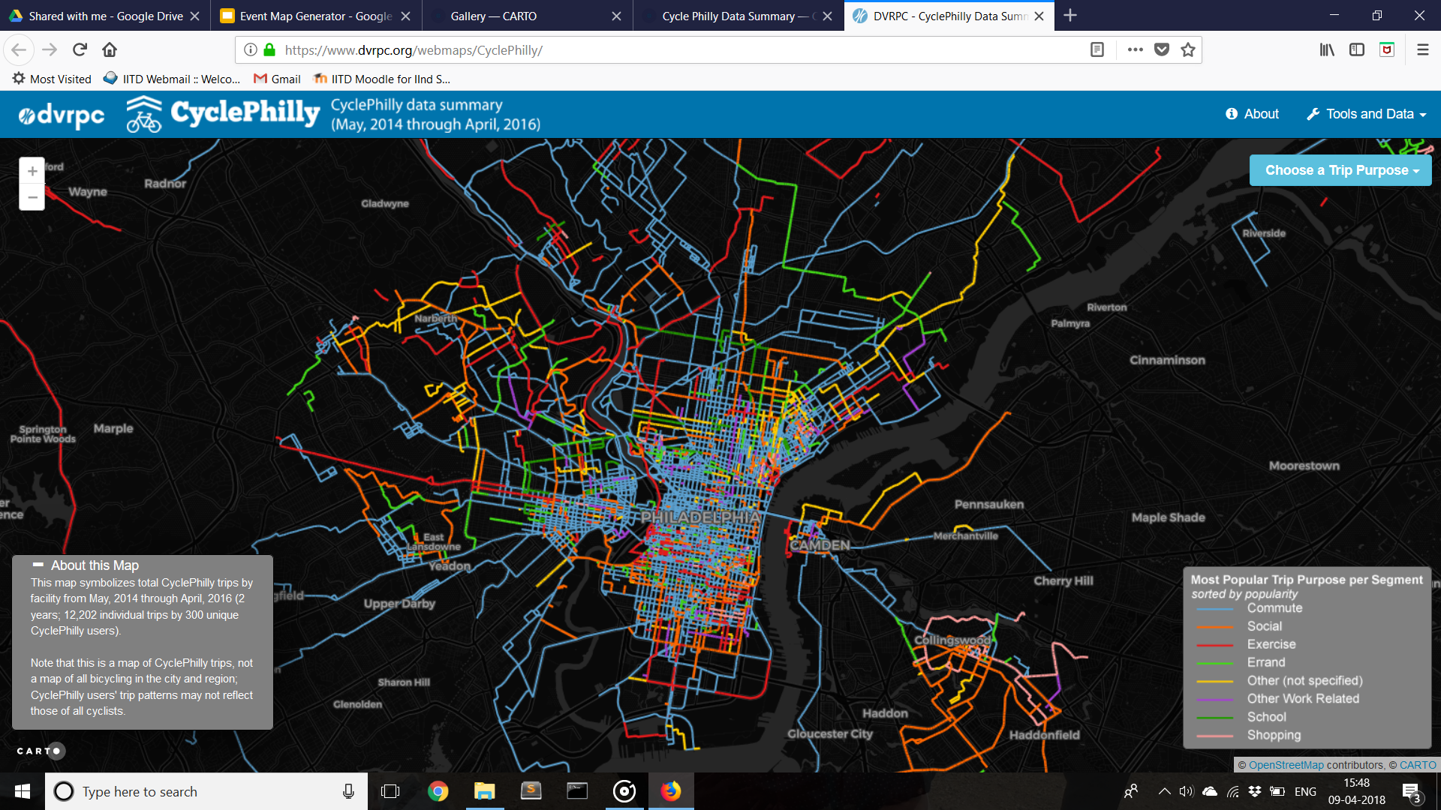
Importance of Location based Data
Transportation - Traffic management and monitoring
Courtesy:cyclephilly
Notes:
Location is an Important attribute of data. Infact 80% of data has some spatial or locational attribute associated to it. This correlation of data and location can be exploited in diff areas:
This map highlights the different purposes of cycle trips made by a group of people based on the colour of path

Slide 3
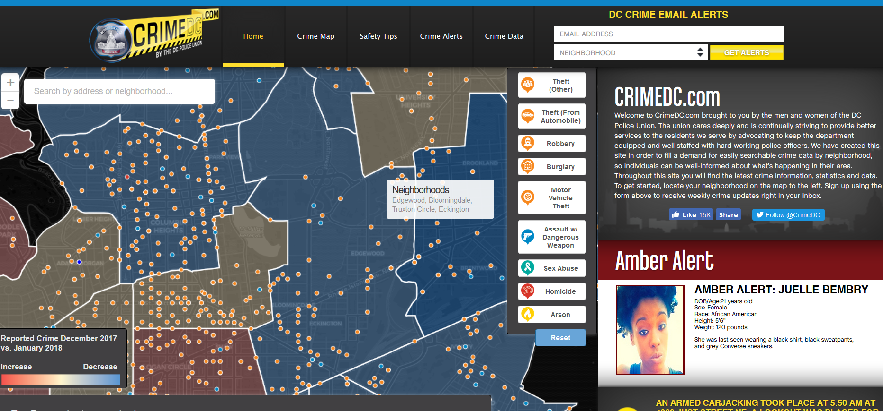
Importance of Location based Data
Tracking criminal activities and optimising patrolling
Courtesy:crimdc.com
Notes:
This is a map which associates recent crime activities with their location and classifies them on the nature of crime. It is maintained by WDCPD.
Other areas like targeted marketting, migration pattern analysis, and monitoring environment

Slide 4
How to depict Location based Data ?
Notes:
Now the question arises as to how do we represent location based data.

Slide 5
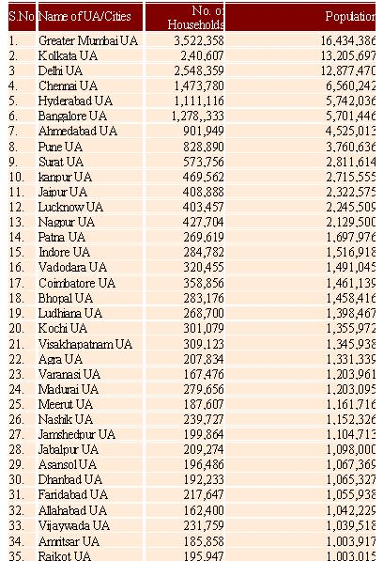
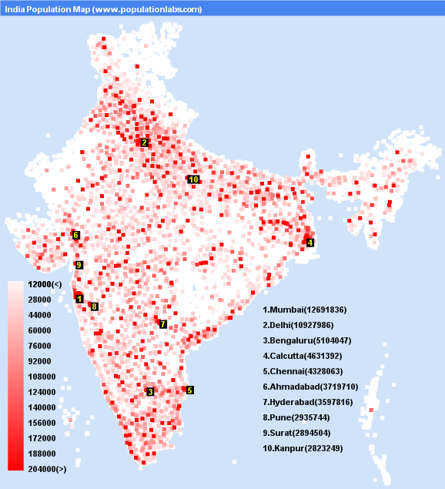
Textual data Vs Visual data
Notes:
We have two options.Either we can list down the data with coordinated OR
On the other hand We can represent the data on map as which is more insight ful. This representation helps us to analyze Relative proximity of data points and draw useful insights. For eg……Identify metro cities in india and population distribution.

Slide 6
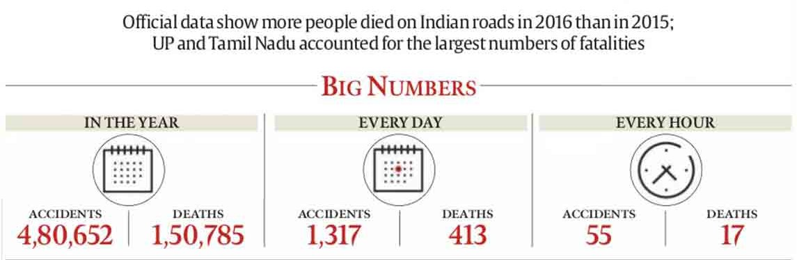
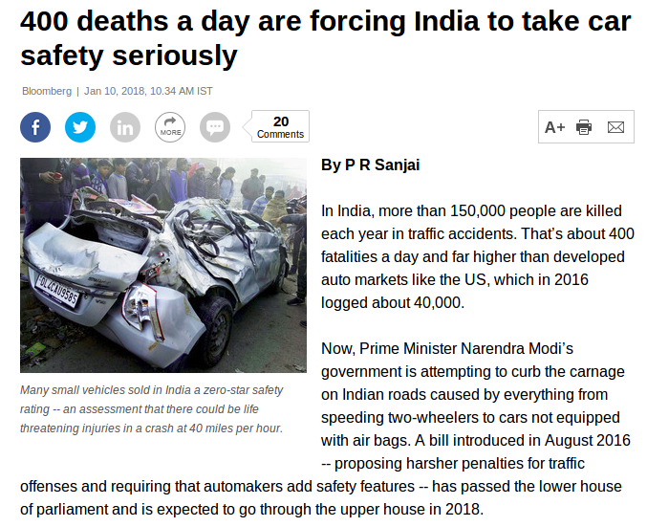
Focus
During summer - Automatic curation of Accident Map
After summer - Extending event map generator to include other applications
Source - The Indian Express
Notes:
Connection from previous slide

Slide 7
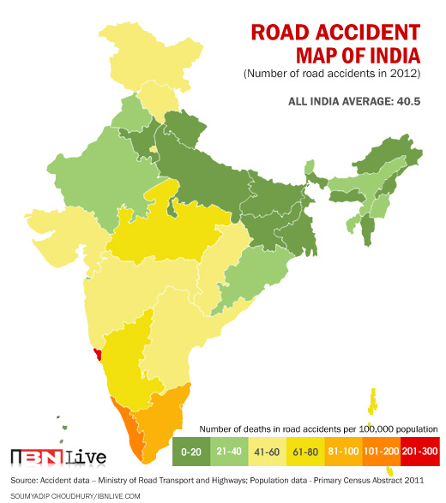
Current Accident Maps
No information on :
Accident prone highways & intersection
Types of vehicles/pedestrian involved
Cause of accident
Notes:
The Current Form of Information that is available : Tell how averaging out the data over large regions dilutes the information and devoid us of essential inferences

Slide 8
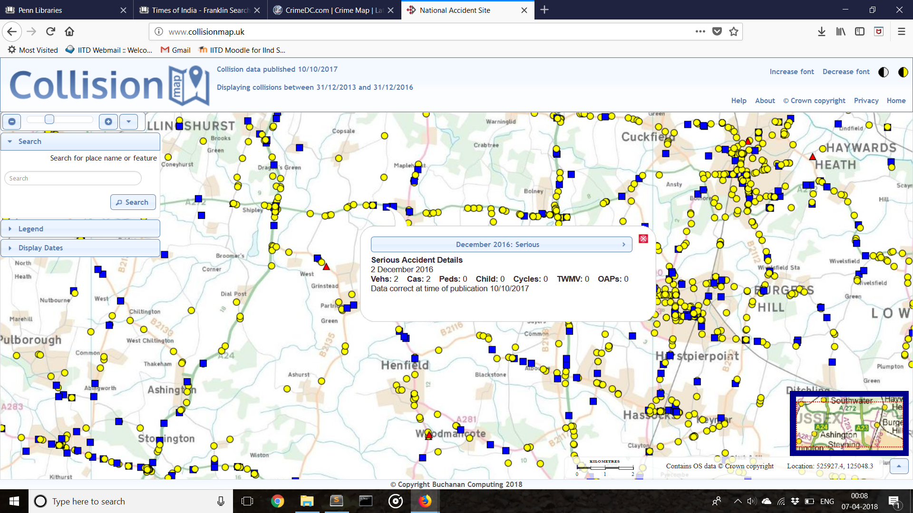
Sample Accident map
Courtesy:http://www.collisionmap.uk/
Notes:
This is the kind of map that we are trying to render, wherein each event can be mapped to its location along with optional access to the attributes of the event

Slide 9
AIM
Natural language processing (NLP) based text mining system
Process accident related information
Sources : Print & Digital Media
Assimilate the insights with suitable mapping and visualization tools.
Notes:
Our Aim during the summer

Slide 10
Approach
1. Data collection
Notes:
No detailed explanation in this slide, simply listing of steps

Slide 11
Approach
1. Data collection
2. Data processing
Notes:
No detailed explanation in this slide, simply listing of steps

Slide 12
Approach
1. Data collection
2. Data processing
3. Geocoding of data
Notes:
No detailed explanation in this slide, simply listing of steps

Slide 13
Approach
1. Data collection
2. Data processing
3. Geocoding of data
4. Plotting and visualisation
Notes:
No detailed explanation in this slide, simply listing of steps

Slide 14
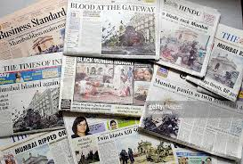

Data Collection : Sources
Online newspaper archives : TOI,The Hindu and Telegraph
  Reliable
  Easily available
  Easy text processing : Journalists follow standard english rules.
Social media(Twitter)
  Traffic authorities & TRIPP have twitter and facebook handles where they post accident related data.
  Lot a data in unorganised form.
  Slang and abbreviations : difficult processing

Slide 15

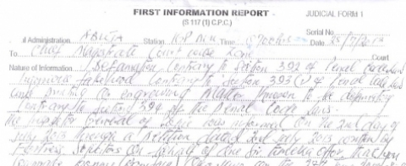
Data Collection : Sources
Has handwritten FIR records for 12 years for all reported accidents in Delhi-NCR
Has manually annotated newspaper accident reports for some months.
Hand written text by different people in various languages makes it difficult to convert text into digital form .

Slide 16

Data Collection : Crawling
Automatically crawl online archives of newspapers for textual data.
2. Scraping the archives which are present in downloaded form.
3. De-Duplication of data in order to avoid unnecessary excessive load.

Slide 17

Data Processing
Conversion of newspaper images to text articles
Classification of articles
Formatting text
Key feature extraction

Slide 18
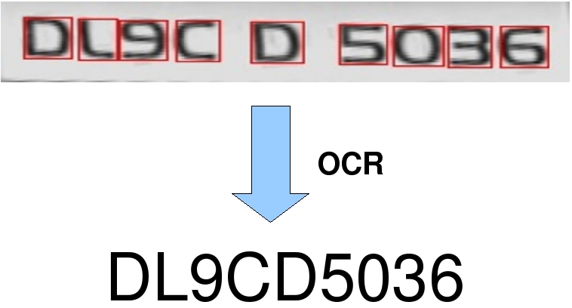
Data Processing
Conversion of newspaper images to text articles using ‘Optical character recognition (OCR)’

Slide 19
Data Processing
2. Classification of articles based on whether they report road accidents or not

Slide 20

Data Processing
2. Classification of articles based on whether they report road accidents or not
By searching accident related keywords
Example keywords :
accident road crash
pedestrian injury death
Highway overspeeding lane jumping
blind spot
Notes:
Main source of data.

Slide 21
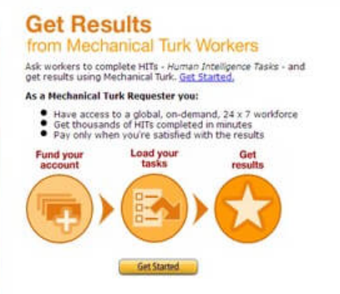

Data Processing
2. Classification of articles based on whether they report road accidents or not
Alternate: Manually label some articles using AMT to form training set ----> Use supervised learning algorithm to train machine to do further classification
Notes:
We will not rely on AMT as it takes time. As we get more and more data through AMT, our output will become better. This step requires time but does not require much contribution from our side so we plan to use the time remaining in this semester for this step.

Slide 22
Data Processing
3. Formatting text to feed into NLP tools like OpenIE.
Open Information extraction (OpenIE) system ---> runs over sentences
Parsing of text paragraphs to individual sentences that are feedable to openIE system.
A car crashed into a truck last night at Karnal Highway.
The car driver was overspeeding and was also drunk.
The cops have registered an FIR against the car driver.
A car crashed into a truck last night at Karnal Highway. The car driver was overspeeding and was also drunk. The cops have registered an FIR against the car driver.

Slide 23

Data Processing
4. Key feature extraction using ‘Natural Language Processing (NLP)’
The U.S. president Barack Obama gave his speech on Tuesday to thousands of people.
Open Information Extraction (OpenIE) System
(Barack Obama, gave, [his speech, on Tuesday, to thousands of people])
Automatically parse news articles to detect location and time, vehicle type, number of casualties, cause of accident …..
Notes:
Label various clauses using AMT

Slide 24
Data Processing
4. Key feature extraction using ‘Natural Language Processing (NLP)’
Problem - OpenIE return different clauses but does not label which clause is location, time, causality, etc.
(A car, crashed, [into the divider, on Tuesday, near Dhaula Kuan])
car
Tuesday
crashing into divider
Dhaula Kuan
Notes:
Label various clauses using AMT

Slide 25
Data Processing
4. Key Feature Extraction using ‘Natural Language Processing (NLP)’
Problem - OpenIE return different clauses but does not label which clause is location, time, causality, etc.
(A car, crashed, [into the divider, on Tuesday, near Dhaula Kuan])
Solution -
Using AMT to create training set for labelling different clauses as location, time, vehicle type, number of casualties, cause of accident, etc.
Then using supervised machine learning for labelling subsequent data.
vehicle type :
car
time :
Tuesday
accident type :
crashing into divider
location :
Dhaula Kuan
Notes:
Label various clauses using AMT

Slide 26
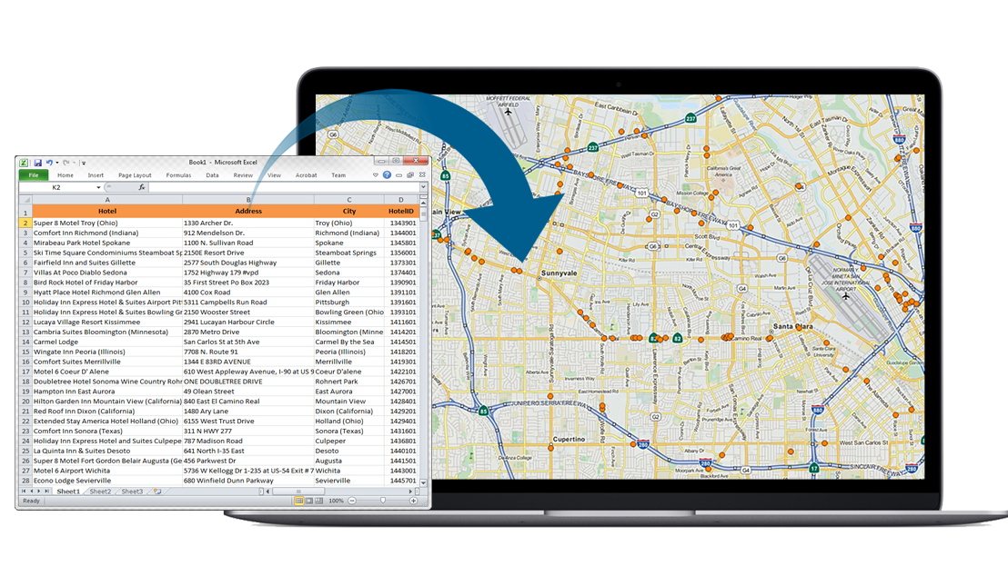
Geocoding
Conversion from address to geographic coordinates
Tool - ‘Google Maps Geocoding API’
Eg. Hauz Khas :
Latitude = N 28° 32' 58.0164"
Longitude = E 77° 12' 0.4932"

Slide 27
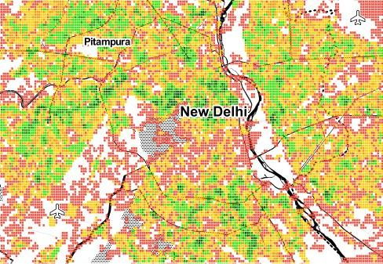
Plotting and Visualisation
Appropriate mapping and visualization to show the extracted information.
Tool - CartoDB, Mapbox, mapsplotlib
Notes:
https://piensaenpixel.carto.com/builder/8a6530e0-5239-11e5-9cc4-0e0c41326911/embed?state=%7B%22map%22%3A%7B%22ne%22%3A%5B30.939924331023445%2C-24.257812500000004%5D%2C%22sw%22%3A%5B53.64463782485651%2C40.07812500000001%5D%2C%22center%22%3A%5B43.34116005412307%2C7.910156250000001%5D%2C%22zoom%22%3A5%7D%7D
General Elections in India
https://carto.com/gallery/twitter-india-elections/
http://cartodb.s3.amazonaws.com/static_vizz/sunrise.html?title=true&description=true&search=false&shareable=true&cartodb_logo=true&layer_selector=false&legends=false&scrollwheel=true&sublayer_options=1%7C1&sql=&zoom=2&center_lat=22.917922936146045&center_lon=51.328125#
Budget Slide (and timeline maybe stepwise )

Slide 28
Benchmarks
Courtesy:http://www.collisionmap.uk/
Notes:
This is the kind of map that we are trying to render, wherein each event can be mapped to its location along with optional access to the attributes of the event

Slide 29
Dynamic Event Maps
Notes:
The modern day solution to such a problem is event maps. For example the given event map shows us the movement to Royal Navy during WW1. By looking at this map we can easily identify strategic ports, sea routes of royal navy and major events of WW1.
Video Link : https://drive.google.com/open?id=1XLbU7tA-27niP-LOqmVs7r5hZQIL1GiP

Slide 30
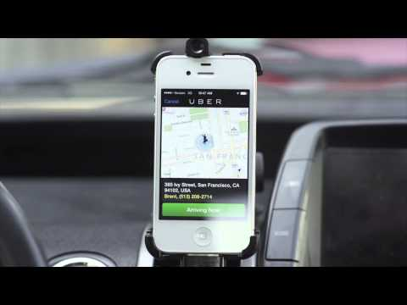
Potential Impact
Can Uber/Ola give voice alerts to drivers near accident prone zones or if they are drowsy
(detected with front camera)?

Slide 31
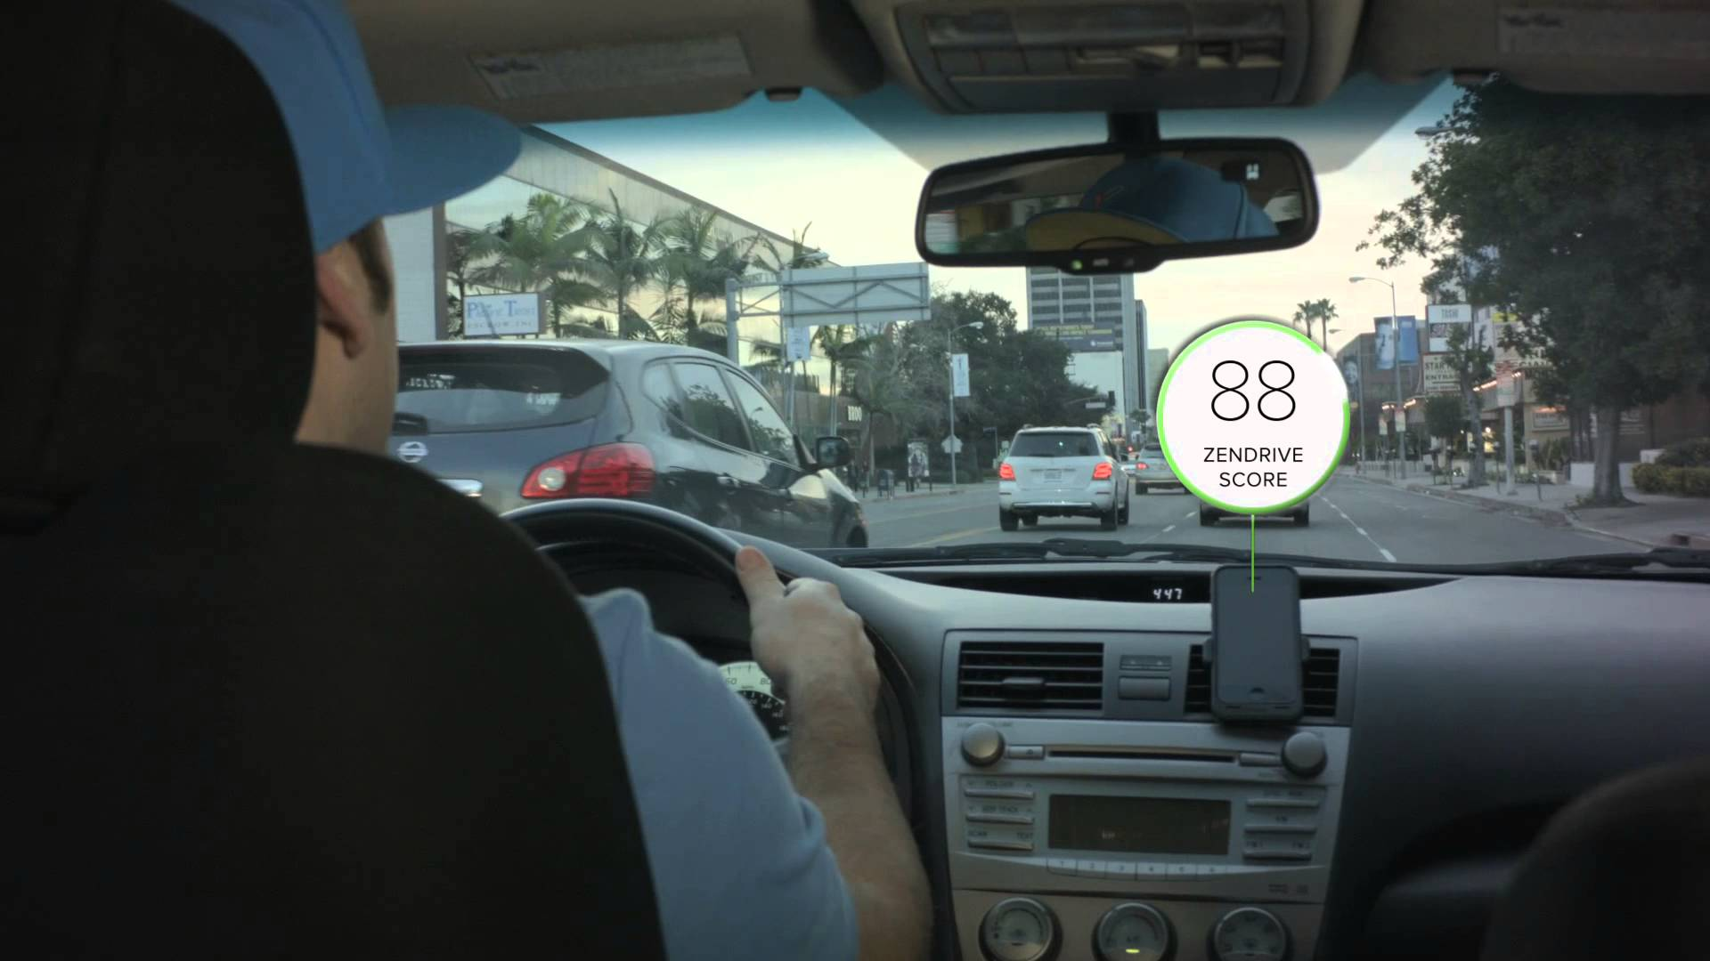
Potential Impact
Can Uber/Ola give voice alerts to drivers near accident prone zones or if they are drowsy
(detected with front camera)?
Can Zendrive rate drivers more strictly based on their behavior in accident prone zones?
Notes:
Zendrive is an app which rates the drivers on the basis of their driving. It uses the sensors in the smartphones along which Google maps to rate its drivers based on their speed pattern, aggressiveness and even phone use.

Slide 32
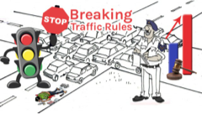
Potential Impact
Can Uber/Ola give voice alerts to drivers near accident prone zones or if they are drowsy
(detected with front camera)?
Can Zendrive rate drivers more strictly based on their behavior in accident prone zones?
Can Vehant install cameras to catch and penalize traffic rule violators be deployed better under budget constraints?
Notes:
Vehant is an startUp by IIT alumni which aims at using digital means to catch violations of traffic rules, in particular, they install cameras at traffic junctions to catch violators.

Slide 33
Potential Impact
Can Uber/Ola give voice alerts to drivers near accident prone zones or if they are drowsy
(detected with front camera)?
Can Zendrive rate drivers more strictly based on their behavior in accident prone zones?
Can Vehant install cameras to catch and penalize traffic rule violators be deployed better under budget constraints?
Prof. Rijurekha Sen has research collaborations with Ola, Zendrive and Vehant, where our fine-grained accident maps will be directly relevant.
Notes:
If an area is prone to a specific type of accidents then architectural changes can be made to prevent those accidents.
For eg. Too many pedestrian involved accidents indicate the need to construct subways and zebra-crossings in the area.

Slide 34
Research Component
0) Open source end-to-end tool.
Exploring situations where openIE fails or is not efficient.
Possible adaptations to openIE to extract labelled clauses.
Share insights with TRIPP for transportation research questions.

Slide 35
Budget and Timeline
Amount of Budget proposed : ₹ 25000
For using Human Intelligence platform : Amazon Mechanical Turk.
Proposing Upper limit of Budget because
  Multiple Instances of use of AMT
Data Collection
2-3 Weeks
Keyword
Search
1 Week
Key feature extraction
2-3 Weeks
Classification of labels
2 Week
Geocoding & Plotting
1 week

Slide 36
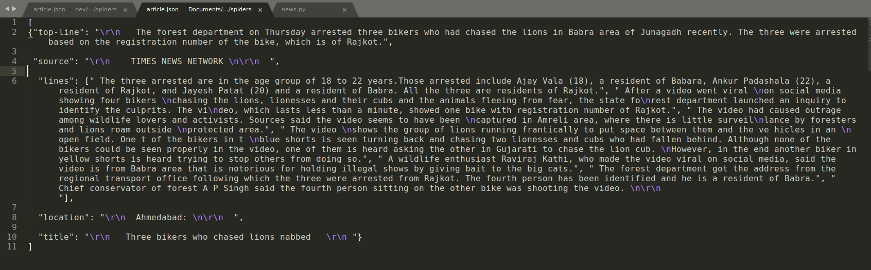
Progress so far
crawled few newspaper articles - url to json
Demarcate fields such as title, author, lines, source, etc.
Notes:
Show in article.json in sublime.

Slide 37
Thank You

